Slide 1
Introduction to Molecular Biology Operations

Slide 2
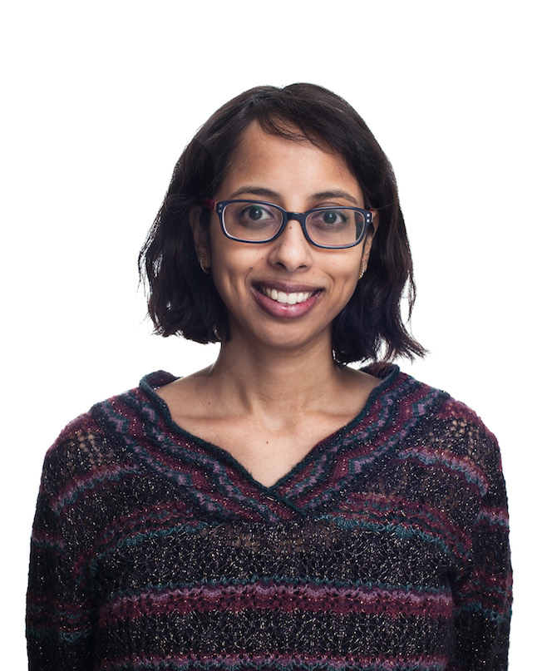
Today’s Instructor
Bioinformatics and Computational Biosciences Branch (BCBB), NIAID
National Institutes of Health, Bethesda, MD USA.
Contact our team via email:
Listserv: ACE-GLOBAL-ANNOUNCE@list.nih.gov
Instructor: poorani.subramanian@nih.gov
Dr. Poorani Subramanian,
Ph.D. in Applied Mathematics
Ongoing Computational Biology projects:
Amplicon & metagenomics microbiome
Eukaryote microbial gene annotation

Slide 3
Class Materials
Tools
UGENE: Okonechnikov K, Golosova O, Fursov M, the UGENE team. Unipro UGENE: a unified bioinformatics toolkit. Bioinformatics 2012 28: 1166-1167.
Benchling [Biology Software]. (2018). https://benchling.com.
Data
S. enterica plasmid NC_011604.1.fasta
Cowpox virus GCF_000839185.1_ViralProj14174_genomic.gbff

Slide 4
Introduction

Slide 5
Biological Molecules
DNA
RNA
Proteins

Slide 6
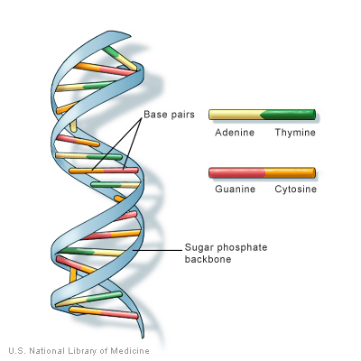
DNA
deoxyribonucleic acid
Long molecule found in the cells of living things
Usually packed into a structure called a chromosome
The complete set of chromosomal* DNA constitutes an organisms' genome
Double helix
4 nitrogenous bases – A,T,G,C
complementary base pairs A~T, G~C
The sequence made by these bases constitute the instructions necessary for life
Notes:
*sometimes genome contains extra-chromosomal DNA - plasmids

Slide 7
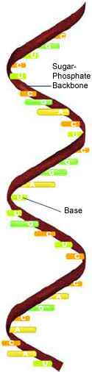
RNA
ribonucleic acid
Single helix
4 nitrogenous bases – A, G, C, and U – uracil instead of thymine
Long molecule found in the cells of living things
Continually being made and broken down
Notes:
DNA helix is B form and more vulnerable to UV radiation than RNA A form
? function is as intermediary to "protect" DNA from damage ?

Slide 8
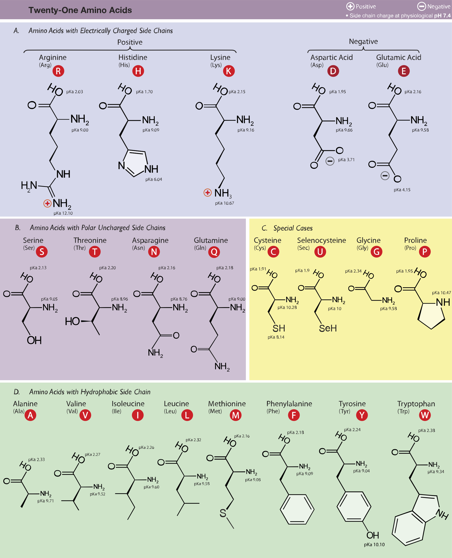
Proteins
large, complex molecules required for the structure, function, and internal regulation of living things
Sequence made up of 20 different amino acids
3D structure is determined in part by this sequence
https://en.wikipedia.org/wiki/Amino_acid#/media/File:Amino_Acids.svg
Notes:
Selenocystein Sec not always considered one of the standard 20

Slide 9
What can DNA and RNA do?
Overview
DNA can replicate
DNA serves as template during transcription for the formation of messenger RNA (mRNA)
mRNA and transfer RNA (tRNA) synthesize proteins during translation
Notes:
Replication – allows for growth and development and reproduction – epigenetics aside, we have the same instructions from birth in all of our cells

Slide 10
Central Dogma of Molecular Biology
Coined by Francis Crick in 1958
"The Central Dogma. This states that once 'information' has passed into protein it cannot get out again. In more detail, the transfer of information from nucleic acid to nucleic acid, or from nucleic acid to protein may be possible, but transfer from protein to protein, or from protein to nucleic acid is impossible. Information means here the precise determination of sequence, either of bases in the nucleic acid or of amino acid residues in the protein. "
Table of the three classes of information transfer suggested by the dogma
General | Special | Unknown
DNA → DNA | RNA → DNA | protein → DNA
DNA → RNA | RNA → RNA | protein → RNA
RNA → protein | DNA → protein | protein → protein
Notes:
A second version of the central dogma is popular but incorrect. This is the simplistic DNA → RNA → protein pathway published by James Watson in the first edition of The Molecular Biology of the Gene (1965). Watson's version differs from Crick's because Watson describes the two-step (DNA → RNA and RNA → protein) pathway as the central dogma.^{[4]} While the dogma, as originally stated by Crick, remains valid today, Watson's version does not.

Slide 11
Replication and PCR
Primer Design

Slide 12
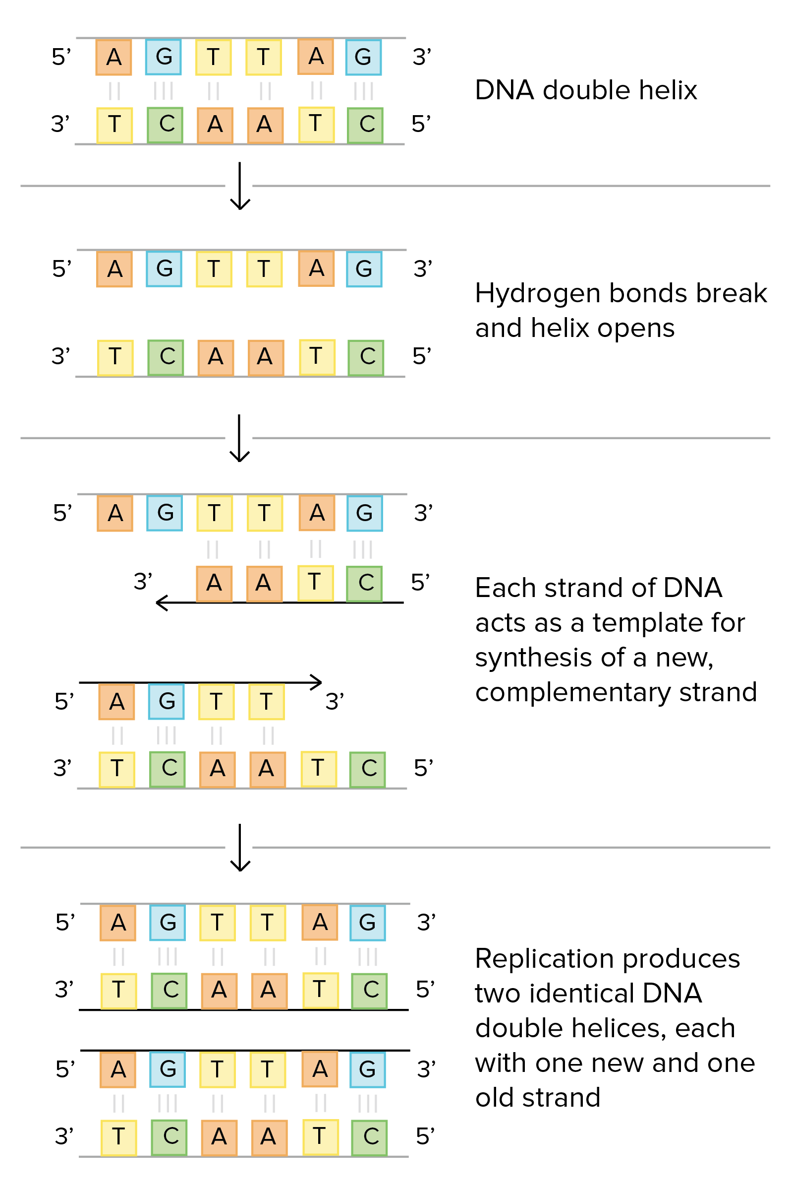
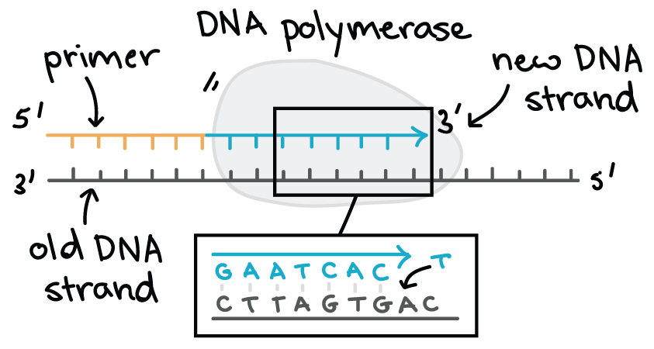
DNA replication
always need a template
can only add nucleotides to the 3' end of a DNA strand
can't start making a DNA chain from scratch, but require a pre-existing chain or short stretch of nucleotides called a primer
proofread, or check their work, removing the vast majority of "wrong" nucleotides that are accidentally added to the chain
figures from Khan Academy

Slide 13
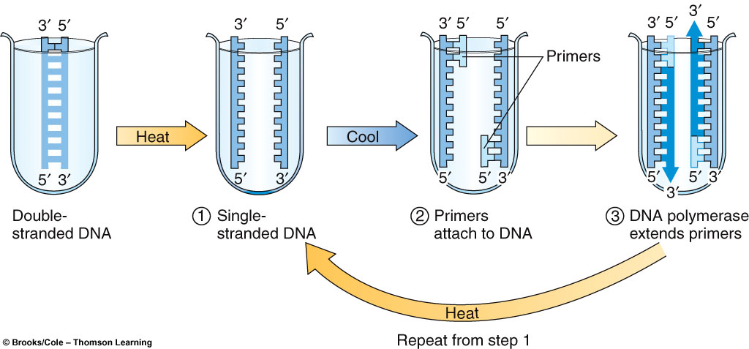
PCR Amplification
PCR – polymerase chain reaction is a method to amplify large quantities of a DNA covering a specific sequence.
Notes:
Basically we need to design a primer – we don't have primase making us a nice RNA primer – we want to amplify specific locations

Slide 14
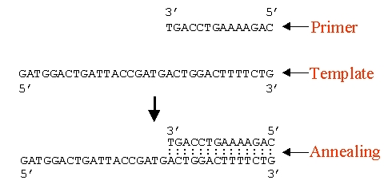
How do we design a primer?
A primer is a short synthetic oligonucleotide which is used in many molecular techniques from PCR to DNA sequencing. These primers are designed to have a sequence which is the reverse complement of a region of template or target DNA to which we wish the primer to anneal.

Slide 15
Primer Design Demo
D. melanogaster mRNA coding for tap, the target of Poxn. Tap encodes a bHLH protein expressed in larval chemosensory organs and involved in the response to sugar and salt. We wish to amplify by PCR the region coding for the HLH motif.
Import NM_079400.3.gb into UGENE
Look for HLH; Helix-loop-helix DNA-binding domain
Add CDS coords
Primer BLAST - https://www.ncbi.nlm.nih.gov/tools/primer-blast/index.cgi?LINK_LOC=BlastHome
https://wiki.bits.vib.be/index.php/Primer_Design#.2ADesigning_regular_PCR_primers_using_Primer3
Notes:
amino acids are encoded by codons of 3 nucleotides so you have to multiply the amino acid positions by three: 155 * 3 = 465 and 211 * 3 = 633
the sequence of the Genbank record contains more than the CDS: the CDS starts at position 112 (green box on figure) meaning that the start codon is located at position 112 in the sequence of the Genbank record. So you have to add 112 to the nucleotide positions: 465 + 112 = 577 and 633 + 112 = 745
In the nucleotide sequence of the RefSeq mRNA record, the domain is located between position +577 and +745.

Slide 16
UGENE
Open Terminal (Ctrl+Alt+T)
In bioinformatics, you need to be flexible! Nothing will work when you need it to!
To that end, you will need to try one of the following 3 ways to launch UGENE:
ugene -ui
sudo ugene -ui
/opt/UGENE/ugene -ui

Slide 17
Translation and Transcription
ORFs and Computational Gene Finding

Slide 18
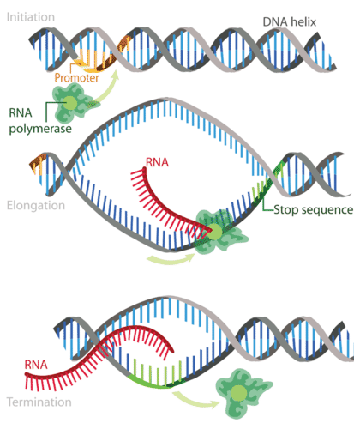
Transcription
Step 1: Initiation RNA polymerase binds to region called the promoter. This signals the DNA to unwind so the enzyme can ‘‘read’’ the bases in one of the DNA strands.
Step 2: Elongation RNA polymerase reads the unwound DNA strand and builds the mRNA molecule, using complementary base pairs. There is a brief time during this process when the newly formed RNA is bound to the unwound DNA. During this process, an adenine (A) in the DNA binds to an uracil (U) in the RNA.
Step 3: Termination RNA polymerase crosses a stop (termination) sequence in the gene. The mRNA strand is complete, and it detaches from DNA.

Slide 19
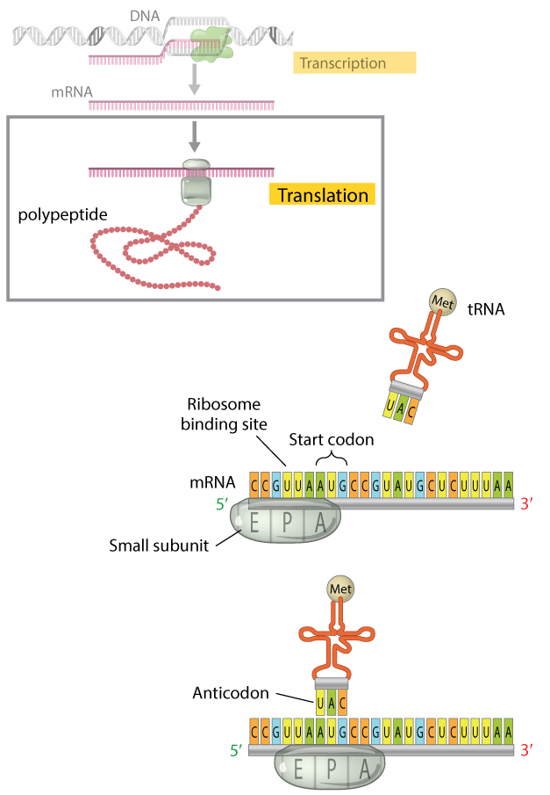
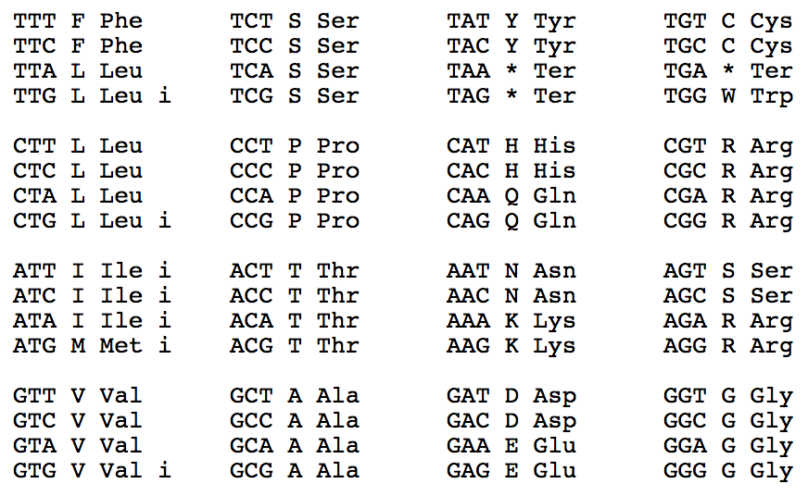
Translation
The Bacterial, Archaeal and Plant Plastid Genetic Code
Notes:
ATG is usual start codon – bacteria also use TTG and GTG

Slide 20
Computational Gene Finding
Open Reading Frame (ORF): Any stretch of DNA that potentially encodes a protein
The identification of an ORF is the first indication that a segment of DNA may be part of a functional gene

Slide 21
Open Reading Frames
ACG TAA CTG ACT AGG TGA AT
CGT AAC TGA CTA GGT GAA
GTA ACT GAC TAG GTG AAT
Each grouping of the nucleotides into consecutive triplets constitutes a reading frame. There are three different reading frames in the 5’->3’ direction and a further three in the reverse direction on the opposite strand.
A sequence of triplets that contains no stop codon is an Open Reading Frame (ORF)

Slide 22
ORFs as gene candidates
An open reading frame that begins with a start codon (usually ATG, GTG or TTG, but this is species-dependent)
Most prokaryotic genes code for proteins that are 60 or more amino acids in length
The probability that a random sequence of nucleotides of length n has no stop codons is (61/64)^{n}
When n is 50, there is a probability of 92% that the random sequence contains a stop codon
When n is 100, this probability exceeds 99%

Slide 23
Finding ORFs with UGENE
NC_011604.1.fasta
NCBI ORF Finder is also nice https://www.ncbi.nlm.nih.gov/orffinder/
Notes:
5841-6794 orf
minimal orf length 300 nt
Genetic code 11
'ATG' and alternative initiation codons;

Slide 24
Recombination
Restriction Enzymes

Slide 25
What are restriction enzymes?
Molecular scissors that cut double stranded DNA molecules at specific points.
Found naturally in a wide variety of prokaryotes – defense against phages
An important tool for manipulating DNA.
Named for bacterial genus, species, strain, and type
Example: EcoR1
Genus: Escherichia Species: coli Strain: R Order discovered: I (roman numeral 1)

Slide 26
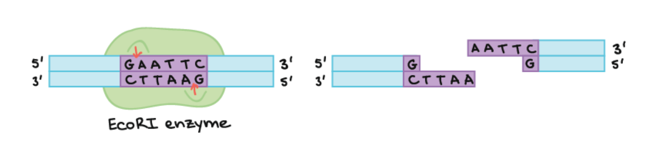
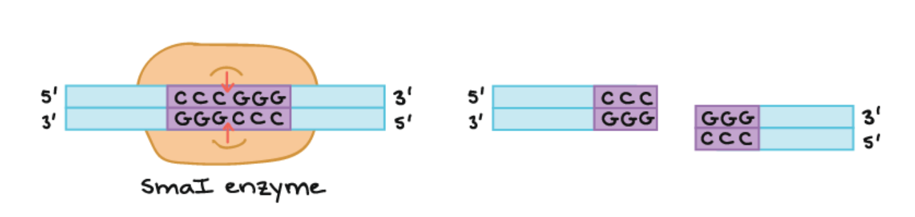
Recognition Sequences
Inverted Repeat Palindromes
figures from Khan Academy

Slide 27
Blunt and Sticky Ends
Sticky End
Blunt End
figures from Khan Academy

Slide 28
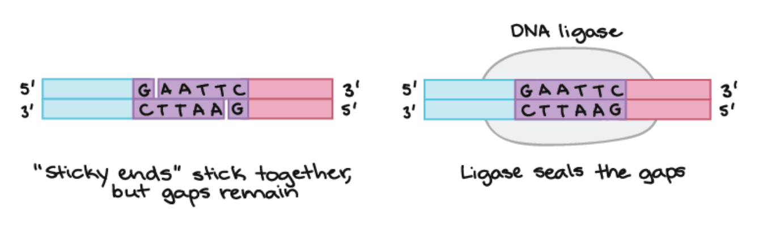
Sticky Ends
Make it easier for enzyme DNA ligase to put the ends back together
Useful for recombinant DNA and cloning
figures from Khan Academy

Slide 29
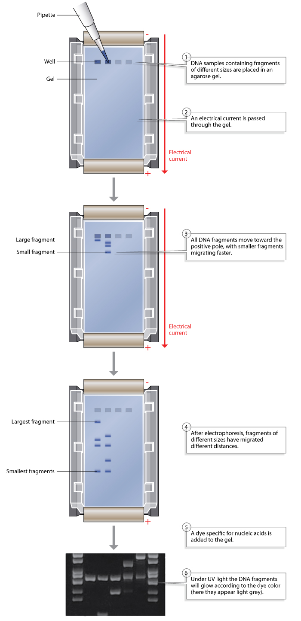
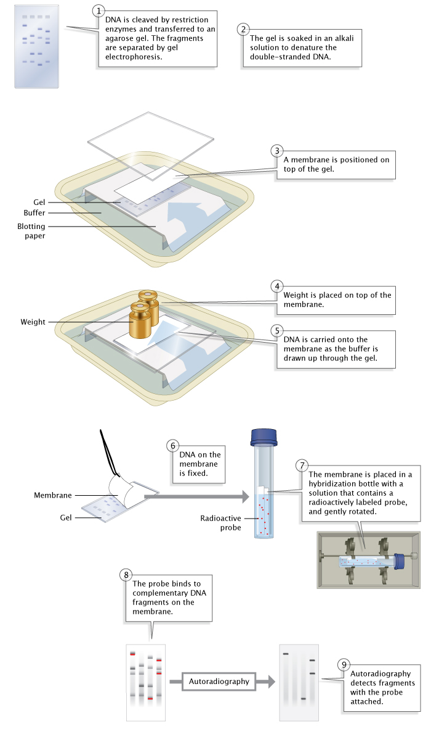
Electrophoresis
from Nature SciTable

Slide 30
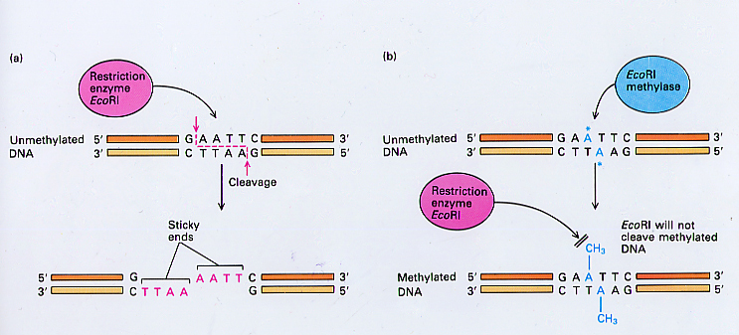
Why doesn't E. coli cut itself?
DNA Methylation

Slide 31
Restriction Enzyme Cut Sites Demo
https://benchling.com/
GCF_000839185.1_ViralProj14174_genomic.gbff

Slide 32
Ideas for Other Topics
Secondary structure for protein
quick metagenomics analysis
Annotate sequences

Slide 33
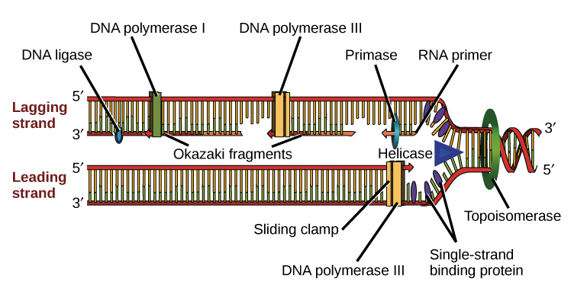
DNA Replication
Helicase opens up the DNA at the replication fork.
Single-strand binding proteins coat the DNA around the replication fork to prevent rewinding of the DNA.
Topoisomerase works at the region ahead of the replication fork to prevent supercoiling.
Primase synthesizes RNA primers complementary to the DNA strand.
DNA polymerase III extends the primers, adding on to the 3' end, to make the bulk of the new DNA.
RNA primers are removed and replaced with DNA by DNA polymerase I.
The gaps between DNA fragments are sealed by DNA ligase.
figures from Khan Academy

